Slide 1

Why the Common Core?: How these Standards are Different
Notes:
This module was last updated on February 2016.

Slide 2
Why are we doing this? We have had standards.
Before Common Core State Standards we had standards, but rarely did we have standards-based instruction.
Long lists of broad, vague statements
Mysterious assessments
Coverage mentality
Focused on teacher behaviors – “the inputs”
Notes:
In this time of implementing the Common Core State Standards, it is very easy to approach this as yet another round of “standards revision.” Many of us have lived through such revision processes, multiple times.
Even though we have had standards across the country since the 1990s, we have not had systemic standards based instruction. There are plenty of reasons why previous versions of standards so rarely led to standards based instruction.
Typical state standards which preceded the Common Core were excessively long and broad. Even if a teacher wanted to teach all of the standards included in a typical grade, there simply are not enough school days in a year – perhaps in several years – to teach what was listed. In addition, the standards themselves were often made of exceptionally broad statements. Many student learning objectives could be aligned to very broad descriptions of learning.
One might think that the assessments designed to evaluate student learning of these standards would be a point of guidance to teachers working from a list of standards too long to teach. State assessments however were often built on vague blue prints that often surveyed or sampled the standards.
Teachers are therefore often left with the “best worst option” of simply covering as many of the standards as possible in order to hedge their bets for what would appear on the assessments. This has created an intense pressure on teachers, who have limited time. The level of student learning is considered only after the pacing charts.
For decades the long lists of standards coupled with accountability pressures have led to an unbalanced focus on what is being taught, rather than on what is being learned.

Slide 3
Results
Previous state standards did not improve student achievement.
Gaps in achievement
Gaps in expectations
NAEP results
ACT 2012 data – College Readiness Benchmark
  All 4 subject areas: 25%
  3 subject areas: 15%
  2 subject areas: 17%
  1 subject area: 15%
  None 28%
College remediation rates
Notes:
So despite a lot of effort, our past efforts to implement standards have not generally led to broad student achievement. Instead, we have lots of evidence that we are still falling short.
We continue to have significant gaps in achievement among racial/ethnic groups, income levels, etc.
While standards were supposed to define the minimum expectations for all students, we have actually had persistent gaps in expectations for students as we attempted to implement a set of standards which simply could not have been thoroughly taught –or learned.
Despite smaller class sizes and a doubling of spending on education over the last four decades, we have had little signs of improvement on the literacy assessments of the National Assessment of Educational Progress (NAEP), which is commonly referred to as “our nation’s report card.” While we have had a slight increase in 4th grade results, 8th grade results have been flat, and the results we get from the 12th grade assessment show a slight dip in proficiency levels.
Another piece of evidence that indicates the need for reform is the data from the ACT assessment. These 2012 results show alarming gaps between the knowledge and skills needed to earn a diploma and the knowledge and skills to actually be prepared for education and training after high school.
This of course leads to incredibly high rates of remediation, costing many of our young adults a significant amount of time and money. Compounding the costs is the fact that remedial students are more likely to drop out of college without a degree. Less than 50 percent of remedial students complete their recommended remedial courses. Less than 25 percent of remedial students at community colleges earn a certificate or degree within eight years. Students in remedial reading or math have particularly dismal chances of success. A U.S. Department of Education study found that 58 percent of students who do not require remediation earn a bachelor’s degree, compared to only 17 percent of students enrolled in remedial reading and 27 percent of students enrolled in remedial math.

Slide 4
What are our expectations?
Based on the beliefs that
A quality education is a key factor in providing all children with opportunities for their future
It is not enough to simply complete school, or receive a credential – students need critical knowledge and skills
This is not a 12th grade or high school issue. It is an education system issue.
Quality implementation of the Common Core State Standards is a necessary condition for providing all students with the opportunities to be successful after high school.
Notes:
The Common Core State Standards are based on a belief that education can lead to improved opportunities for all children and that we need to do more than just give them a credential. We need to create a K-12 system of education in which we focus our energy, efforts, and resources on what really matters to support their success.

Slide 5
Principles of the CCSS
Fewer - Clearer - Higher
Aligned to requirements for college and career readiness
Based on evidence
Honest about time
Notes:
So, where do the Common Core State Standards fit in with this conversation? In order to improve education, we need to have a set of standards that are powerful, meaningful, and achievable. During the development of the Standards, the design principles were often described as fewer, clearer, and higher. Although these are relative, and perhaps even subjective terms, it is worth understanding how these make the Common Core State Standards different in approach than typical state standards.
In terms of fewer, the design principle is that these standards can be learned within a year. There is very little repetition from year to year of the same standards.
The standards are clearer in that they more precisely describe outcome expectations, rather than vague or broad descriptions of learning.
The standards are higher with respect to what is meant by higher – not harder – standards. Having higher standards means that what is included in the Common Core State Standards is actually intended for all students each year; there is congruence between what is stated and what is expected.
The next issue then is how to get to fewer, clearer, higher. Unlike typical standards development or revision processes in which groups of stakeholders are gathered in committees to advocate for their individual positions, preferences, pet topics, etc., these standards relied on evidence for what students need in order to be prepared for college and careers. It turns out that a lot of what we spend time and energy on in school K-12, doesn’t buy students much after graduation. This of course wouldn’t be a problem if time was not such a finite resource. Because time is limited however, decisions had to be made. Rarely in education do we pay so much attention to the limited resource of time. We often, rather, keep adding and adding initiatives. It is always easy to add one more thing. These Standards were built with the awareness that each additional expectation came at the cost of time spent on what was already included. It is exceptionally important in understanding these Common Core State Standards that we acknowledge and accept the power of the eraser as well as, perhaps after, the power of the pen.

Slide 6
ELA/Literacy: 3 shifts
Regular practice with complex text and its academic language
Reading, writing and speaking grounded in evidence from text, both literary and informational
Notes:
In discussing the Common Core State Standards, it is exceptionally helpful to be mindful of the “big picture” implications. These implications have been commonly referred to as “The Shifts.” You can think of these as understanding the forest from the trees. There is certainly a lot of detail not included here and yet very important to the Standards. Understanding these shifts deeply is a very powerful way to start. There are three shifts in ELA/Literacy and three in mathematics. The idea here is not just to hear these shifts, but to internalize them. Listen closely and learn so that you know these shifts and what they mean for you in your role. Let’s start with the first two:
The first shift in ELA/Literacy is to build knowledge through content-rich nonfiction. Think of the two parts of this statement– first, we are building knowledge from text. Students use the text as a source of knowledge. This of course means that in addition to reading stories, students are reading nonfiction. The CCSS requires that in elementary school about half of what students read should be fiction and about half of what they read should be nonfiction. In order for these texts to support the building of knowledge, students should read a coherent set of texts that actually support the building of knowledge through text. This is different from what is typically happening in classrooms now. Currently as much as 80% of what students read is fiction and when they do read nonfiction, it is often as an isolated “experience in reading nonfiction” such as in a weekly news magazine. These texts don’t build knowledge through a series of nonfiction texts and they rely on a great deal of knowledge outside of the text. In middle and high schools the standards require attention to literacy across the content areas. In order to work toward college and career readiness students need the specific literacy skills of science and social studies. This means that science teachers and social studies support student literacy as a way to enhance knowledge and skills in the content area. There are standards included in the Common Core that specifically describe these expectations. They are an important component - not a suggestion for implementation, not an appendix, but an essential part. In looking at a student’s reading requirements across the school year, across all classes middle and high school students should be reading about 70% nonfiction and 30% fiction. When the content areas are on board, this means that the English class still focuses on literature with some addition of nonfiction.
The second shift may seem rather obvious, but incredibly it is a significant shift from current typical practice. In this second shift students work with the text as a source of evidence. This is a strong college and career-ready skill. In response to text, students are actually required to use evidence from the text. This is contrasted with typical current practice in which students are often asked to answer questions, make arguments, give opinions, construct projects in response to text while requiring no knowledge, comprehension or experience with actually reading the text. We often refer to this with the slogan of reading like a detective and writing like a reporter.

Slide 7
Non-Examples and Examples
Not Text-Dependent
Text-Dependent
In “Casey at the Bat,” Casey strikes out. Describe a time when you failed at something.
In “Letter from a Birmingham Jail,” Dr. King discusses nonviolent protest. Discuss, in writing, a time when you wanted to fight against something that you felt was unfair.
In “The Gettysburg Address” Lincoln says the nation is dedicated to the proposition that all men are created equal. Why is equality an important value to promote?
What makes Casey’s experiences at bat humorous?
What can you infer from King’s letter about the letter that he received?
“The Gettysburg Address” mentions the year 1776. According to Lincoln’s speech, why is this year significant to the events described in the speech?
Notes:
Text-dependent questions require students to pay attention to the text at hand and to draw evidence from that text.
What does this look like in the classroom?
Teachers insist that classroom experiences stay deeply connected to the text on the page and that students develop habits for making evidentiary argument both in conversation and in writing. Teachers assess comprehension of a text by evaluating students’ use of evidence in speaking and writing.
Students have rich and rigorous conversations and develop writing all dependent on a common text.
This is not to say that text-to-self connections are entirely absent, but rather, with this shift, deep understanding of the text should precede students making those connections.

Slide 8
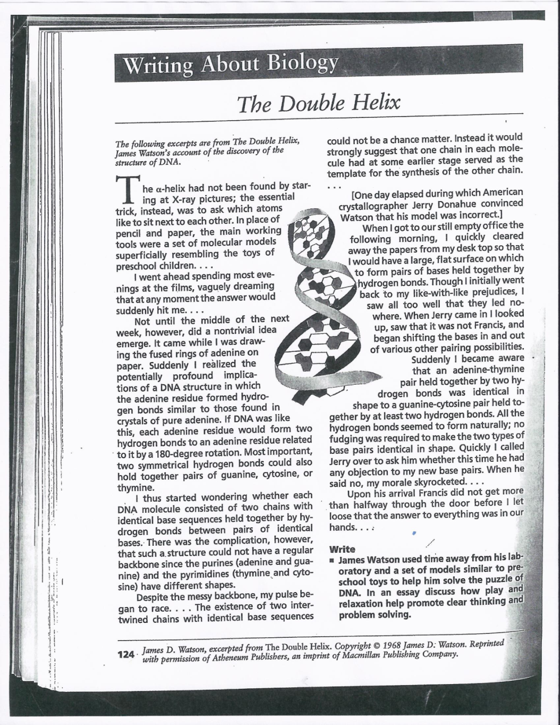
Example?
James Watson used time away from his laboratory and a set of models similar to preschool toys to help him solve the puzzle of DNA. In an essay discuss how play and relaxation help promote clear thinking and problem solving.
Notes:
Here is another great example. It is an excerpt from a high school biology textbook. Students are given the excellent opportunity to read an excerpt from James Watson’s memoir about the discovery of DNA. The excerpt gives a great description as a first-person account.
Then take a look at the question that students answer in response. Here is a hint: the answer to the question cannot be found in the text. In fact, you clearly do not need to read the text in order to answer the question. Imagine that students put in the work of closely reading and making sense of this piece. The question provides no reinforcement, no reward, no “pay off” for that work.

Slide 9
ELA/Literacy: 3 shifts
Regular practice with complex text and its academic language
Reading, writing, and speaking grounded in evidence from text, both literary and informational
Building knowledge through content rich nonfiction
Notes:
The third shift concerns what students are reading. In the research that informed the development of these standards it was found that students were required to read texts significantly more complex in both college and career training programs than the texts they had read in high school. This is one of the reasons why students face such challenge in those post-secondary programs.
In addition to the skills of ELA/Literacy, these standards also include a “staircase of complexity” throughout so that students complete high school ready for the challenging texts they will need to read and understand. Text complexity refers to the themes and concepts of the text as well as the vocabulary and syntax of the text.
The language referred to in the shift as “academic language” includes vocabulary and sentence structure that supports students in reading complex text across the content areas. The specific vocabulary here is not the typical content-specific vocabulary, but rather, words such as dedicate, ignite, consequence .

Slide 10
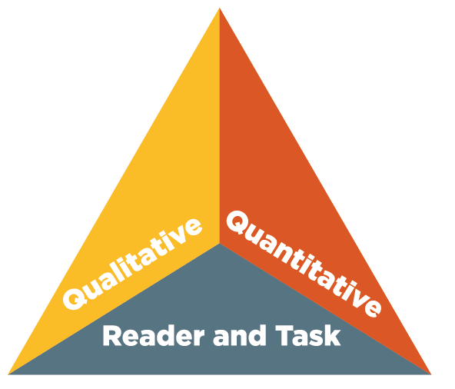
Text Complexity
Appendix A
Supplement to Appendix A
Appendix B
CCSS address what and how students read.
Notes:
Text complexity is a term widely included in discussions regarding the Common Core State Standards, but often with little depth of understanding regarding what makes a text complex. The Standards include excellent resources to support the understanding of text complexity and the related research.
The complexity level is determined by both quantitative and qualitative measures. The details of text complexity are well described in Appendix A of the Standards, one of the supplemental readings offered with this module. New tools have been developed since the Standards were developed to help determine qualitative text complexity. Those materials are available on www.achievethecore.org
Students who struggle with reading almost always have gaps in their vocabulary and their ability to deal with more complex sentence structures. This too is well documented in research.
Too often, less proficient students are given texts at their level where they do not see these features, where the demands of vocabulary and sentence structure are lowered. Though this is done for the kindest of reasons, it has disastrous consequences. Day by day, differentiating by level of text during instructional time increases the achievement gap between high performers and those who struggle.
Students cannot address gaps in their vocabulary and develop the skill of unpacking complex syntax when they are not given the opportunity to work with materials that provides those opportunities.
With that said, there is a place for providing students with text more appropriately matched to their individual reading abilities in order to build fluency and provide opportunity for increasing the volume of reading. But those texts cannot be the primary texts for instruction.

Slide 11
Mathematics: 3 shifts
Focus: Focus strongly where the Standards focus.
Notes:
In mathematics there are also three shifts. You could engage in an interesting discussion with the ELA/Literacy standards as to whether or not to address all three shifts at once, or where to start. For the mathematics standards there is no option. You must start with focus. Mathematics education in this nation is often described as a “mile-wide and an inch-deep.” We cover lots and lots of topics year after year. The pressure of coverage makes little time available for students to build a strong command of anything, including the understanding and skills which they will be required to build upon as they progress toward more complex mathematical concepts.
The Common Core State Standards have modeled the standards of high-performing countries by focusing on a more narrow set of math concepts and skills to make room for deeper understanding. The potential for the CCSS to improve math education can only be realized if we first make room in the classroom to support student learning.
Jason Zimba, one of the lead of authors of the Common Core State Standards for Mathematics, has said that “focus compromised is not focus.” This points to the great risk in simply going through an alignment study in preparing to implement the Standards. In order to change the outcomes for students we need to commit to narrowing the focus and simply cutting out or delaying some of the topics typically found in our math curriculum.

Slide 12
Traditional U.S. Approach
 | K 12
Number and Operations
Measurement and Geometry
Algebra and Functions
Statistics and Probability
Notes:
This slide presents a visualization of how U.S standards used to be arranged, giving equal importance to all four areas - like “shopping aisles.” Each grade goes up and down the aisles, tossing topics into the cart, losing focus. This visualization, and the curriculum which it represents, shows no priority. The CCSS domain structure communicates the changing emphases throughout the elementary years (e.g., Ratios and Proportional Relationships in grades 6 and 7).

Slide 13
Focusing attention within Number and Operations
 | Operations and Algebraic Thinking |  |  |  |  |  |  | Expressions and Equations |  |  |  | Algebra
 |  |  |  |  |  |  | → |  |  |  | →
 | Number and Operations—Base Ten |  |  |  |  |  | → | The Number System
 |  |  |  |  |  |  |  |  |  |  | →
 |  |  |  | Number and Operations—Fractions |  |  | →
 | K | 1 | 2 | 3 | 4 | 5 |  | 6 | 7 | 8 |  | High School
Notes:
In contrast to the prior slides visualization, this picture shows a shape. Early emphasis on operations and algebraic thinking and number and operations – base ten build to more sophisticated concepts in middle school and then to authentic algebra, rather than the all too common “experience with algebra” for all.

Slide 14
Priorities in Mathematics
Grade | Focus Areas in Support of Rich Instruction and Expectations of Fluency and Conceptual Understanding
K–2 | Addition and subtraction, measurement using whole number quantities
3–5 | Multiplication and division of whole numbers and fractions
6 | Ratios and proportional reasoning; early expressions and equations
7 | Ratios and proportional reasoning; arithmetic of rational numbers
8 | Linear algebra and linear functions
Notes:
This chart shows the major priority areas in K-8 math. These are concepts which demand the most time, attention, and energy throughout the school year.
These are not topics to be checked off a list during an isolated unit of instruction. Rather, these priority areas will be present throughout the school year through rich instructional experiences.

Slide 15
Mathematics: 3 shifts
Focus: Focus strongly where the Standards focus.
Coherence: Think across grades, and link to major topics with grades.
Notes:
In the second shift, coherence, we take advantage of focus to actually pay attention to sense-making in math. Coherence speaks to the idea that math does not consist of a list of isolated topics.
The Standards themselves, and therefore any resulting curriculum and instruction, should build on major concepts within a given school year as well as major concepts from previous school years.

Slide 16
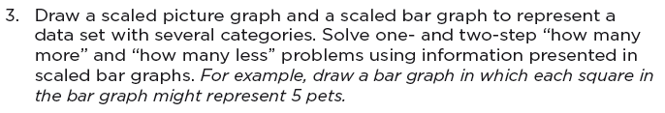
Coherence: Link to major topics within grades
Example: data representation
Standard 3.MD.3
Notes:
Instead of bar charts being “yet another thing to cover,” detracting from focus, this standard tells you how to link bar charts to the major work of the grade. This contrasts with typical practice in which it is not uncommon for instruction that focuses on data representation to miss the opportunity to reinforce work with operations by having students use calculators when they are not working on “calculation.”

Slide 17
Mathematics: 3 shifts
Focus: Focus strongly where the Standards focus.
Coherence: Think across grades, and link to major topics within grades.
Rigor: In major topics, pursue conceptual understanding, procedural skill and fluency, and application.
Notes:
The third shift is Rigor. This word can mean many different things. For purposes of describing the shifts of the standards, it does not mean “more difficult.” For example, stating that “the standards are more rigorous” does not mean that “the standards are just harder.” Here rigor is about the depth of what is expected in the standards, and also about what one should expect to see happening in the classroom, in curricular materials, and so on.
The Standards do not offer a choice between focus on conceptual understanding or fluency or application. They instead require equal intensity of all three. In practical terms, it is not enough to merely know your multiplication facts in third grade, but students must also understand the concept of multiplication and what it represents and be able to apply that understanding and fluency to solving real-world or unexpected application problems.

Slide 18
Required Fluencies in K-6
Grade | Standard | Required Fluency
K | K.OA.5 | Add/subtract within 5
1 | 1.OA.6 | Add/subtract within 10
2 | 2.OA.2 2.NBT.5 | Add/subtract within 20 (know single-digit sums from memory) Add/subtract within 100
3 | 3.OA.7 3.NBT.2 | Multiply/divide within 100 (know single-digit products from memory) Add/subtract within 1000
4 | 4.NBT.4 | Add/subtract within 1,000,000
5 | 5.NBT.5 | Multi-digit multiplication
6 | 6.NS.2,3 | Multi-digit division Multi-digit decimal operations
Notes:
Fluent in the particular Standards cited here means “fast and accurate.” It might also help to think of fluency in math as similar to fluency in a foreign language: when you’re fluent, you flow. Fluent isn’t halting, stumbling, or reversing oneself.
The word fluency was used judiciously in the Standards to mark the endpoints of progressions of learning that begin with solid underpinnings and then pass upward through stages of growing maturity.
Some of these fluency expectations are meant to be mental, and others may need pencil and paper. But for each of them, there should be no hesitation in getting the answer with accuracy.

Slide 19
Mathematical Practices
Make sense of problems and persevere in solving them.
Reason abstractly and quantitatively.
Construct viable arguments and critique the reasoning of others.
Model with mathematics.
Use appropriate tools strategically.
Attend to precision.
Look for and make use of structure.
Look for and express regularity in repeated reasoning.
Don’t Bureaucratize
Notes:
The Common Core State Standards for Mathematics include standards for mathematical practices in addition to standards in content.
The Standards for Mathematical Practice describe varieties of expertise that mathematics educators at all levels should seek to develop in their students. These practices rest on important “processes and proficiencies” with longstanding importance in mathematics education.
In integrating the practice standards, it is important that we do not bureaucratize these expectations – as in “problem solving Mondays” or “perseverance Tuesdays.” Rather, these practices should be integrated into the content instruction and practice.

Slide 20
Power of the Shifts
Know them – both the what and the why
Internalize them
Apply them to your decisions about
  Time
  Energy
  Resources
  Assessments
  Conversations with parents, students, colleagues
Continue to engage with them:
  www.achievethecore.org
  Follow @achievethecore on Twitter
Notes:
The shifts are a very powerful entrance point to the standards. They should be well understood by all stakeholders. Once everyone understands these shifts, they can be used as “anchors” to guide the many decisions to be made about the use of time, energy, resources, assessments, etc. The CCSS and the larger mission of supporting students in college and career readiness should weave its way into all decisions and conversations in the education system.

